Slide 1
Unit 4
Knowledge Representation

Slide 2
Knowledge
Knowledge means understanding or information about something based on facts, experience, learning, and interpretation.
Knowledge is not just raw information.
It is information that has been understood, organized, and used.
Example:
Knowing “Kathmandu is the capital of Nepal” is knowledge.
Knowing how to solve a math problem is also knowledge.
Knowledge in AI
In Artificial Intelligence, knowledge includes:
Facts
Concepts
Relationships
Experience
AI systems use this knowledge to reason, make decisions, and solve problems, similar to how humans think.

Slide 3
Why Knowledge is Needed in AI
Decision Making - Knowledge helps AI systems make logical and informed decisions. Example: Medical AI uses medical knowledge to suggest treatments.
Efficiency - Well-organized knowledge makes problem solving faster and more accurate. Example: Search engines quickly give results because knowledge is structured.
Learning - AI can improve by learning from existing knowledge and past experiences. Example: Recommendation systems learn from user behavior.
Communication - Knowledge helps machines understand human language and instructions. Example: Chatbots answering questions.

Slide 4
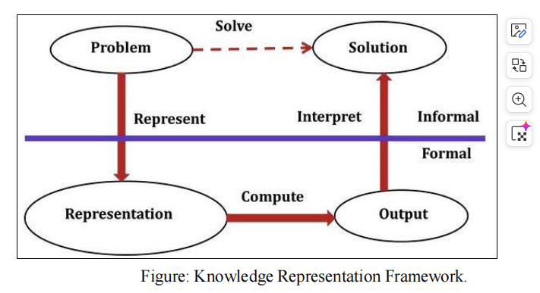
Knowledge Representation Framework
This diagram shows how humans and computers work together to solve a problem using knowledge.

Slide 5
Knowledge Representation Framework
1. Problem (Informal Stage)
First, a human describes a problem in normal spoken language.
Example: “Find the shortest path to reach college.”
This is called informal knowledge because it is easy for humans but not for computers.
2. Representation (Formal Stage)
The problem must be converted into a formal language (rules, logic, symbols, data structures) so that a computer can understand.
Example: Roads = nodes, Distance = numbers, Map = graph
This step is called knowledge representation.
3. Compute
After the problem is represented formally:
The computer uses algorithms.
It processes the knowledge.
It calculates an answer.
Example: AI runs a shortest-path algorithm.

Slide 6
Knowledge Representation Framework
4. Output
The computer produces a result in formal form.
Example:
Path A → B → C with distance 5 km.
5. Interpret (Back to Informal)
Finally, the output is converted into human-understandable language.
Example: “Take this road; it is the fastest route.”
So, the full flow is:
Problem → Representation → Compute → Output → Solution

Slide 7
Why Computer Needs Well-Defined Problem Description
Computers cannot guess meanings like humans. They need:
Clear rules
Exact structure
Logical representation
That’s why we convert:
Informal knowledge (human thinking) ➡ into Formal knowledge (computer language)
This process is also called:
Conversion of implicit knowledge (inside human mind) ➡ to explicit knowledge (clearly defined for computer).

Slide 8
Types of Knowledge Represented in AI Systems
1. Object Knowledge
Facts about things in the world.
Example: “A car has wheels and an engine.”
2. Events
Actions or happenings.
Example: Driving a car, Rain falling
3. Performance Knowledge
Knowledge about how to do something (behavior or skills).
Example: Steps to drive a car, Procedure to solve a problem

Slide 9
Types of Knowledge Represented in AI Systems
4. Meta-Knowledge
Knowledge about knowledge itself.
Example: Knowing which strategy works best, Understanding what we know or don’t know.
5. Facts
True statements about reality.
Example: “Kathmandu is the capital of Nepal.”

Slide 10
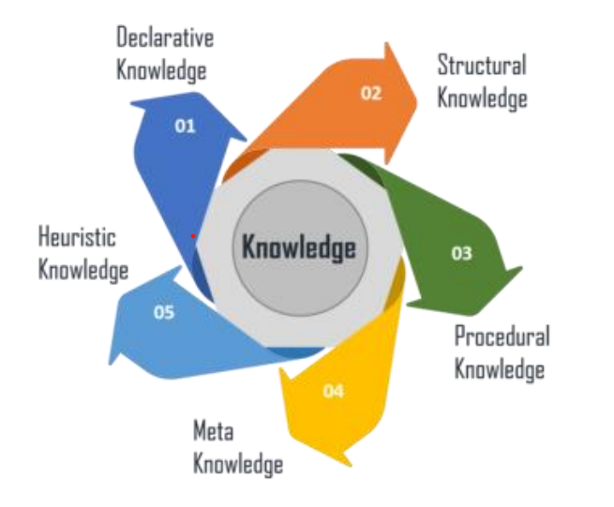
Types of Knowledge
1. Declarative Knowledge — “Knowing WHAT”
Facts and descriptions about the world.
Examples:
Kathmandu is the capital of Nepal.
Water boils at 100°C.
It answers What is true?

Slide 11
Types of Knowledge
2. Structural Knowledge — “Knowing RELATIONSHIPS”
Shows how concepts are connected.
Examples:
Tree → Plant → Living Organism
Company organizational hierarchy
It explains how things relate to each other.

Slide 12
Types of Knowledge
3. Procedural Knowledge — “Knowing HOW”
Steps, rules, or methods to do something.
Examples:
Riding a bicycle
Baking a cake
Solving equations
It answers How to perform a task.

Slide 13
Types of Knowledge
4. Meta Knowledge — “Knowledge about Knowledge”
Understanding how knowledge itself works.
Examples:
Knowing which learning strategy is best
Managing a knowledge database
It helps decide how to use knowledge effectively.

Slide 14
Types of Knowledge
5. Heuristic Knowledge — “Smart Shortcuts”
Experience-based rules that help solve problems faster.
Examples:
Choose shorter path first.
Focus on important exam topics.
Not always perfect but very useful.

Slide 15
Knowledge Representation (KR) System and its Properties
Knowledge Representation (KR) is a core area of Artificial Intelligence that focuses on how knowledge about the real world can be formally structured so that machines can understand and reason with it.
It defines how knowledge is encoded inside intelligent systems.
It allows machines to perform reasoning such as:
Deduction
Decision-making
Problem solving
Drawing conclusions
In simple terms, KR is the bridge between human knowledge and machine reasoning.

Slide 16
Knowledge-Based Agents
A knowledge-based agent is an AI system that uses stored knowledge to perform tasks intelligently.
Example Uses
Medicine (diagnosis systems)
Engineering (design systems)
Finance (decision support systems)
These agents analyze available knowledge and make logical decisions.

Slide 17
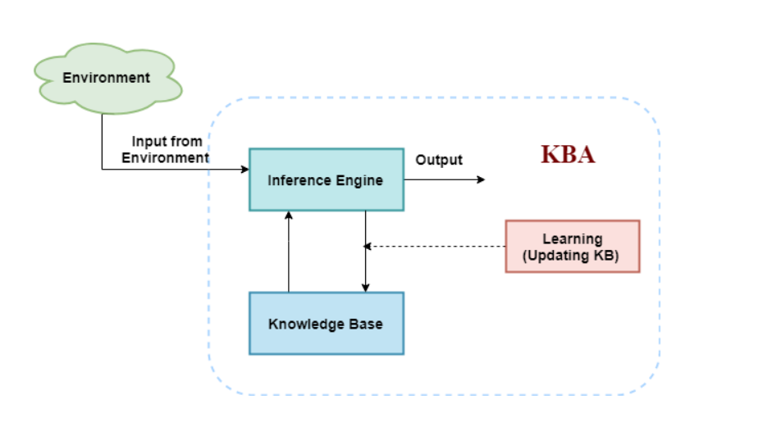
Architecture of knowledge-based agent

Slide 18
Components of a Knowledge-Based Agent
A knowledge-based agent consists of two main parts:
A. Knowledge Base (KB)
The knowledge base is a structured collection of information used by the agent.
It may contain:
Explicit knowledge
Facts
Rules
Statements
Implicit knowledge
Relationships
Patterns
The knowledge base is typically stored in:
Databases
Logic structures
Semantic networks or ontologies (structured frameworks that define the concepts, relationships, and rules within a specific domain to help computers understand, interpret, and reason about data.)

Slide 19
Components of a Knowledge-Based Agent
B. Inference System
The inference system is responsible for reasoning using the stored knowledge.
It performs logical operations to generate new information from existing facts.
Common Reasoning Methods
Deduction – deriving certain conclusions from rules.
Induction – forming general rules from examples.
Abduction – finding the most likely explanation.
The inference system updates the knowledge base by generating new facts.
Main Reasoning Strategies
Forward Chaining
Starts from known facts.
Applies rules to produce new conclusions.
Data-driven approach.
Backward Chaining
Starts from a goal or hypothesis.
Works backward to verify supporting facts.
Goal-driven approach.

Slide 20
Requirements of a Good Knowledge Representation System
A strong KR system must satisfy several important properties:
1. Representational Accuracy
Ability to represent all necessary knowledge correctly.
Should capture real-world concepts clearly.
2. Inferential Adequacy
Capability to generate new knowledge from existing structures.
Supports reasoning and logical conclusions.
3. Inferential Efficiency
Helps the system reason efficiently.
Guides the inference process toward useful conclusions.
4. Acquisitional Efficiency
Ability to easily acquire or learn new knowledge.
Supports automatic updates and learning mechanisms.

Slide 21
Issues in Knowledge Representation
The main goal of KR is to support effective inference, but several challenges arise:
Important Attributes -Identifying relevant properties of objects.
Relationship Between Attributes - Understanding how different concepts connect.
Choosing Granularity -Deciding how detailed the representation should be.
Too detailed → complex system.
Too simple → loss of important information.
Set of Objects - Determining which objects should be included in the model.
Finding the Right Structures - Selecting suitable KR models such as:
Logic representation
Frames
Semantic networks
Ontologies

Slide 22
Types of Knowledge Representation Systems
Knowledge Representation (KR) is the way an AI system stores knowledge so that it can understand, reason, and make decisions. Main KR techniques:
Logical Representation
Semantic Network
Frame
Conceptual Graph
Conceptual Dependency (CD)
Script
Production System

Slide 23
Logical Representation
Logical representation uses formal logic rules to represent knowledge.
It works like mathematics — everything has:
Syntax → structure of sentences. It decides how we can construct legal sentences in logic. It determines which symbol we can use in knowledge representation. Also, how to write those symbols.
Semantics → meaning of sentences. Semantics are the rules by which we can interpret the sentence in the logic. It assigns a meaning to each sentence.

Slide 24
Logical Representation
Types of logic:
Propositional logic
Predicate logic
Temporal logic
Description logic
Advantages
Good for reasoning
Very precise and clear
Basis of many programming languages
Disadvantages
Hard to design
Not very natural like human thinking
Can be computationally expensive

Slide 25
Semantic Network
A semantic network is a graph-based representation.
It uses:
Nodes → objects/concepts
Arcs → relationships
This representation consist of mainly two types of relations:
IS-A relation (Inheritance)
Kind-of-relation

Slide 26
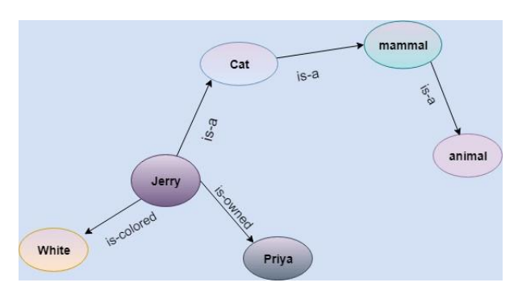
Semantic Network
Example: Following are some statements which we need to represent in the form of nodes and arcs.
Statements:
• Jerry is a cat.
• Jerry is a mammal
• Jerry is owned by Priya.
• Jerry is brown colored.
• All Mammals are animal

Slide 27
Semantic Network
Advantages
Easy to visualize
Very natural way to represent knowledge
Disadvantages
Slower computation
No strong logical quantifiers
Depends on designer

